Slide 1
Minimum Spanning Trees
SUBMITTED BY :- DIMPAL KATANIYA
ROLL NO. :- 181210022
CSE 2ND YEAR (G-1)

Slide 2
SPANNING TREE :-
A spanning tree T of an undirected graph G = (V, E) is a sub-graph of G, which contains the minimum possible number of edges so that it can connect all the nodes.
A graph may have several spanning trees.
If a graph is not connected then it does not have any spanning tree.
Minimum number of edges required to connect all nodes = number of nodes – 1

Slide 3
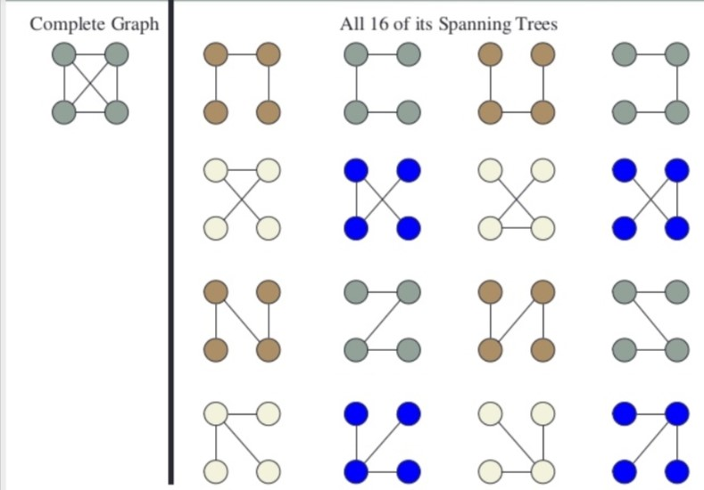
Example of SPANNING TREE :-
For a complete graph containing n nodes there will be n^(n-2) possible spanning tree.
For k4 there will be
4^(4-2) = 16
spanning trees as shown.

Slide 4
MINIMUM SPANNING TREE : -
It is a spanning tree for a connected weighted undirected graph whose sum of weights is minimum among all possible spanning trees.
A graph may have several minimum spanning trees

Slide 5
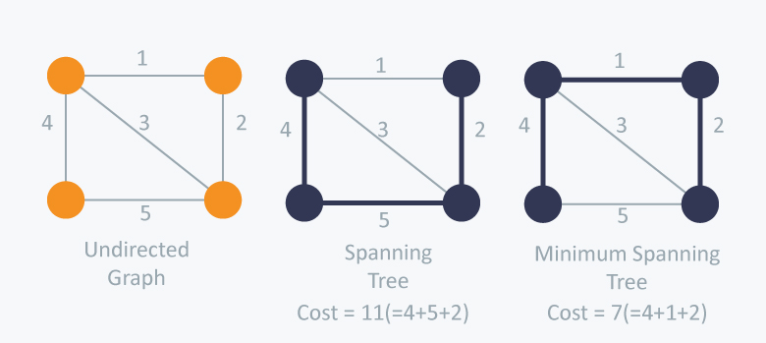
Example of minimum SPANNING TREE :-

Slide 6
Methods to find minimum spanning TREE :-
There are mainly two methods that are used to find minimum spanning tree out of a connected weighted graph :-
Prim’s algorithm
Kruskal’s algorithm

Slide 7
1. Prim’s algorithm
Prim’s Algorithm also use Greedy approach to find the minimum spanning tree. In Prim’s Algorithm we grow the spanning tree from a starting position.
As a greedy algorithm, Prim’s algorithm will select the cheapest edge and mark the vertex. So we will simply choose the edge whose weight is minimum.
Then we grow the tree with neighbor that is connect by the edge of minimum weight.

Slide 8
Algorithm :-
MST-PRIM(G,w,r)
for each u є G.V
u.key = ∞
u.π = NIL
r.key = 0
Q = G.V
while Q != ;
u = EXTRACT-MIN(Q)
for each v є G.Adj[u]
if v є Q and w(u,v)< v.key
v. π = u
v.key = w(u,v)

Slide 9
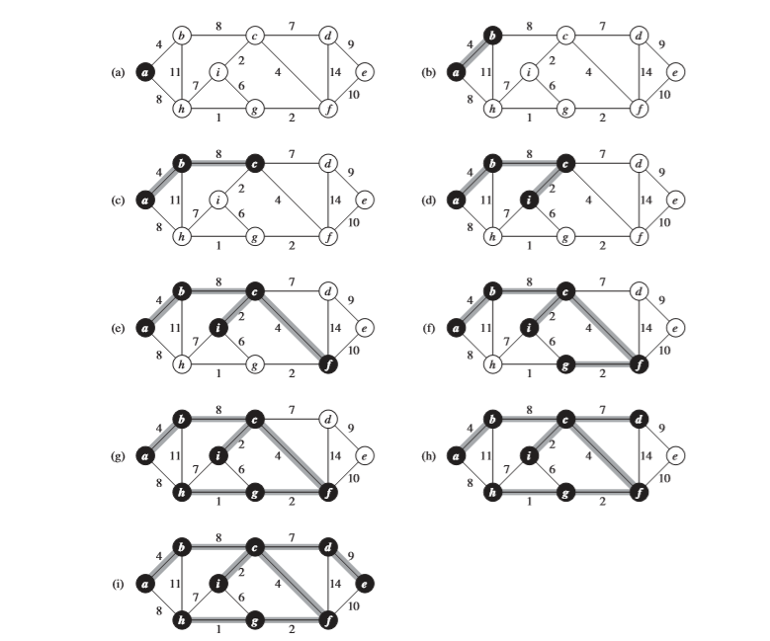
Example problem :-

Slide 10
Time complexity analysis :-
The time complexity of the Prim’s Algorithm is O((V+E)logV)
because each vertex is inserted in the priority queue only once and insertion in priority queue take logarithmic time.

Slide 11
2. Kruskal’s algorithm
Kruskal’s Algorithm builds the spanning tree by adding edges one by one into a growing spanning tree. Kruskal's algorithm follows greedy approach as in each iteration it finds an edge which has least weight and add it to the growing spanning tree
Firstly it will sort the graph edges with respect to their weights.
Then start adding edges to the MST from the edge with the smallest weight until the edge of the largest weight.
Only add edges which doesn't form a cycle , edges which connect only disconnected components.
Stop when it contains n-1 edges where n = number of nodes in graph.

Slide 12
Algorithm :-
MST-KRUSKAL(G,w)
A = ;
for each vertex v є G.V
M AKE-SET(v)
sort the edges of G.E into nondecreasing order by weight w
for each edge (u,v) є G.E, taken in nondecreasing order by weight
if FIND-SET(u) != FIND-SET(v)
A = A U {(u,v)}
UNION(u,v)
return A

Slide 13
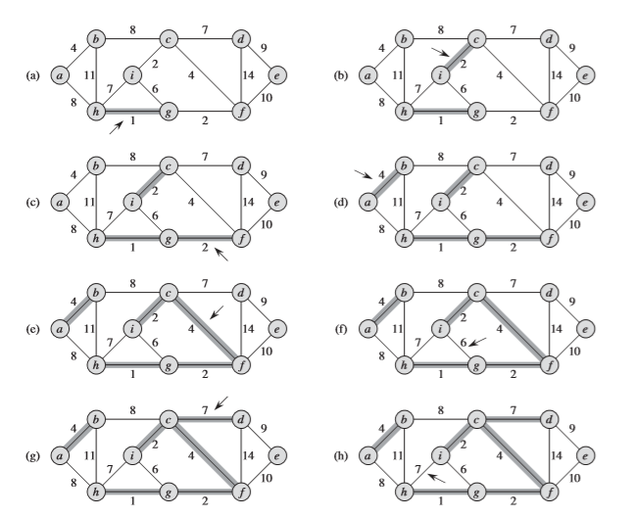
Example problem :-

Slide 14
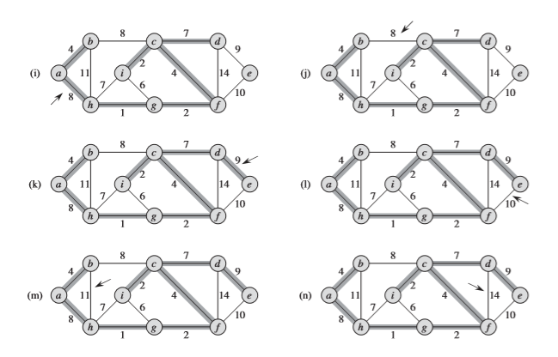
Example problem :-

Slide 15
Time complexity analysis :-
In Kruskal’s algorithm, most time consuming operation is sorting because the total complexity of the Disjoint-Set operations will be O(ElogV), which is the overall Time Complexity of the algorithm.

